Slide 1

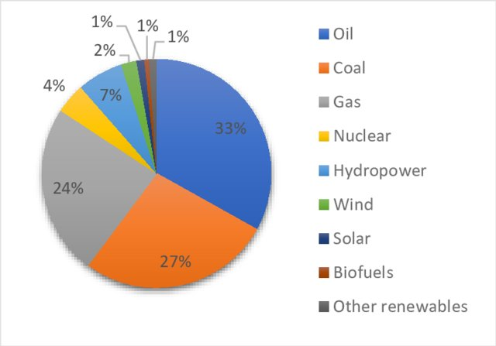

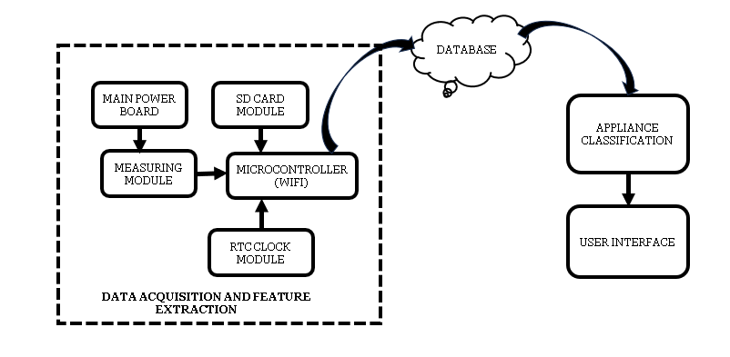
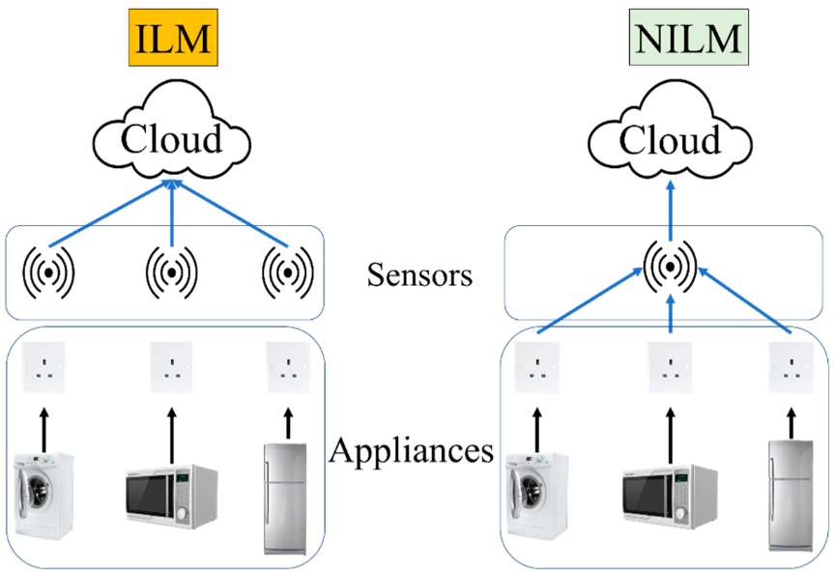
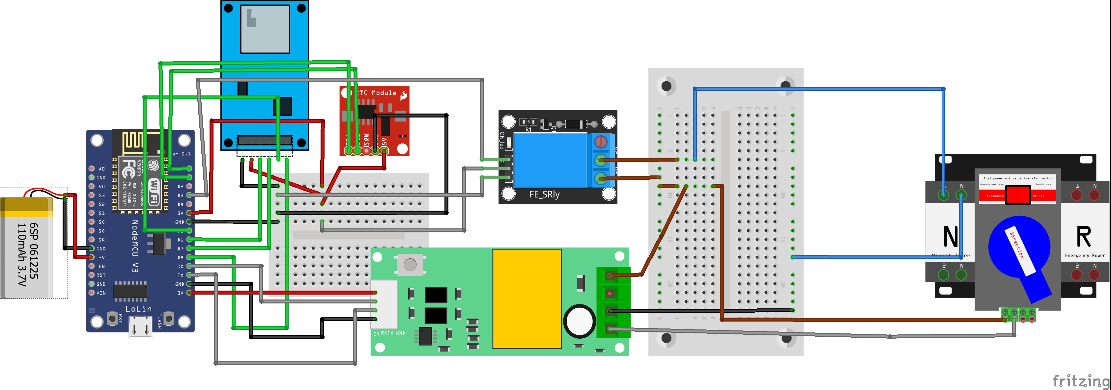
to develop a non-intrusive system to track the consumption of individual loads for consumers.
to furnish consumers with detailed information on appliance usage.
to create a system aimed at decreasing and conserving electrical energy in residential structures.
to promote energy efficiency, reduce consumption patterns, and enable efficient demand-side management through system development.
NON INTRUSIVE LOAD MONITORING
Ogundeji Abiola Samuel (EEG/2018/114)
Obafemi Awolowo University(Electronic and Electrical Engineering)
INTRODUCTION
BLOCK DIAGRAM
CURRENT WORK
This Study focuses on Non-intrusive Load Monitoring (NILM) for household energy management
NILM involves analysis of energy usage without direct appliance interference
This approach provides robust and efficient solution for energy monitoring
I am working on integrating the data acquisition components.
I am also in the process of writing an Arduino Sketch to handle data processing and transmission to the database.
FIGURE 1: Global Fossil Fuel Consumption
The measuring module takes the total electrical power reading from the main power board. The microcontroller with wifi capability, saves the electrical data on the SD-Card. The RTC module adds the time stamp to the collected data. The saved data is now sent to the database for further processing.
ILM and NILM
FUTURE WORK
PROBLEM STATEMENT
I plan to carry out feature extraction and appliance classification.
Global fossil fuel consumption impacts climate change.
Household energy use comprises over 30% of total energy consumption.
Research shows effective feedback of energy usage can save up to 20% .
ILM energy monitoring methods are costly.
There is a need for affordable, non-intrusive load monitoring.
FIGURE 3: Block Diagram of the NILM System
CONCLUSION
FIGURE 2: Installation of Sensor(s) between NILM vs ILM
EXPERIMENTAL
SET-UP
Research indicates that providing users with feedback on their appliances’ energy consumption can lead to a 20% reduction in household energy consumption.
This reduction in energy consumption helps to mitigate climate change caused by the consumption of fossil fuels by electrical generators.
The study aims to develop a non-intrusive method for monitoring individual appliance energy consumption.
However, as the study is ongoing, results are not yet available.
METHODOLOGY
Data Acquisition: Low frequency or High Frequency Sampling
Feature Extraction: Steady state signature and Transient state signature
Appliance Classification: Supervised and Unsupervised machine learning, using Neural Networks
FIGURE 4: Breadboard Implementation of Data Acquisition

